Slide 1
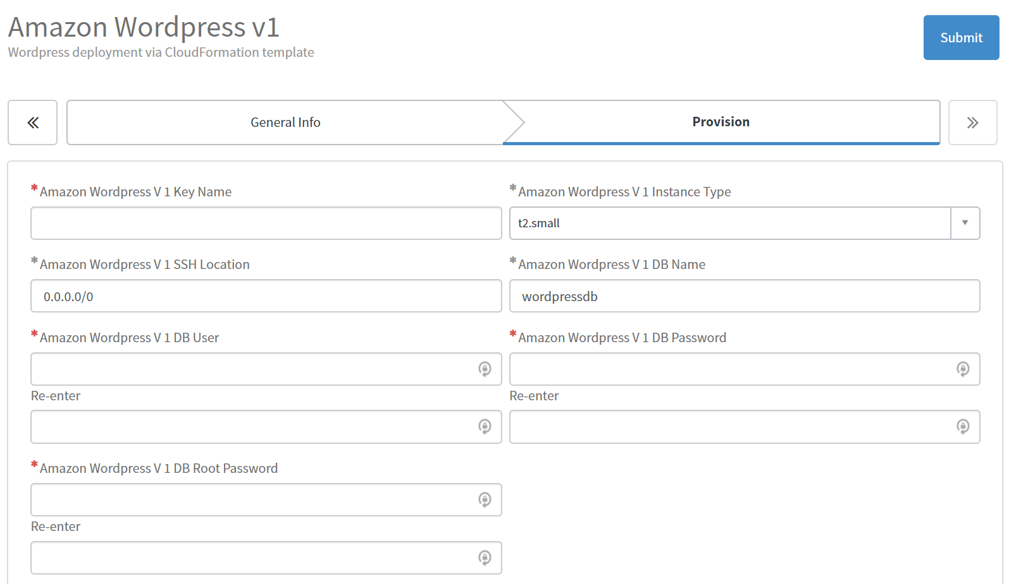
Existing AWS security key. Be sure to choose an existing key name from the region this is going into. Region shows as “location” in General Info tab, here.
1-to-16-character alphanumeric database username. (Not sure why it treats this input as a password and asks for re-entry.)
8-to-41-character alphanumeric database root password. Cannot be the same as regular DB password (at right).
8-to-41-character alphanumeric database password. Cannot be the same as root DB password
(at left).

